Slide 1
RISK MANAGEMENT

Slide 2
RISK
PM-BOK define – "A Risk is an uncertain event or condition that, if it occurs, has a positive or negative effect on a project’s objectives".
PRINCE2 - UK government-sponsored project management standard, defines risk as "the chance of exposure to the adverse consequences of future events".

Slide 3
Categories of Risk
Project risks affect schedule or resources;
Technical (Product) risks affect the quality or performance of the software being developed;
Business risks affect the organisation developing or procuring the software.
(More on next slide)

Slide 4
Categories of Risk
Sub-categories of Business risks
Market risk – building an excellent product or system that no one really wants
Strategic risk – building a product that no longer fits into the overall business strategy for the company
Sales risk – building a product that the sales force doesn't understand how to sell
Management risk – losing the support of senior management due to a change in focus or a change in people
Budget risk – losing budgetary or personnel commitment

Slide 5
Software risks

Slide 6
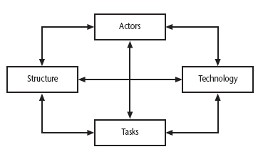
Sociotechnical Model of Risk Categorization
Lyytinen – Mathiassen – Ropponen risk framework
Notes:
This is based on Lyytinen’s sociotechnical model of risk
Actors relate to all those involved in the project including both developers, users and managers e.g. a risk could be that high staff turnover leads to information of importance to the project being lost
Technology – both that used to implement the project and that embedded in the project deliverables – risk could be that the technologies selected are not in fact appropriate.
Structure – this includes management procedures, risk here is that a group who need to carry out a particular project task are not informed of this need because they are not part of the project communication network
Tasks – the work to be carried out. A typical risk is that the amount of effort needed to carry out the task is underestimated.
A risk could be well belong to more than one of the four areas – for example, estimates being wrong could be influenced by problems with actors (e.g. lack of experience with a technical domain) or the structure (over optimism of managers keen to win work).

Slide 7
A Framework for Dealing with Risk
The planning for risk includes these steps:
Risk identification – what risks might there be?
Risk analysis and prioritization – which are the most serious risks?
Risk planning – what are we going to do about them?
Risk monitoring – what is the current state of the risk?

Slide 8
Risk Identification
Approaches to identifying risks include:
Use of checklists – usually based on the experience of past projects
Brainstorming – getting knowledgeable stakeholders together to get their concerns

Slide 9
Boehm’s Top 10 Development Risks
Risk | Risk reduction techniques
Personnel shortfalls | Staffing with top talent; job matching; teambuilding; training and career development; early scheduling of key personnel
Unrealistic time and cost estimates | Multiple estimation techniques; design to cost; incremental development; recording and analysis of past projects; standardization of methods
Developing the wrong software functions | Improved software evaluation; formal specification methods; user surveys; prototyping; early user manuals
Developing the wrong user interface | Prototyping; task analysis; user involvement
Notes:
Barry Boehm surveyed software engineering project leaders to find out the main risks that they had experienced with their projects. For each risk, some risk reduction techniques has been suggested.

Slide 10
Boehm’s Top 10 Development Risks
Gold plating | Requirements scrubbing, prototyping, design to cost
Late changes to requirements | Change control, incremental development
Shortfalls in externally supplied components | Benchmarking, inspections, formal specifications, contractual agreements, quality controls
Shortfalls in externally performed tasks | Quality assurance procedures, competitive design etc
Real time performance problems | Simulation, prototyping, tuning
Development technically too difficult | Technical analysis, cost-benefit analysis, prototyping , training
Notes:
‘Gold plating‘ refers to inclusion of features that in fact are unnecessary and which end up never actually being used.

Slide 11
Risk Assessment – Analysis and Prioritization
Identify the damage and likeliness (probability) for each risk. This can be done by estimating the Risk Exposure.
Risk exposure (RE)
= (potential damage) x (probability of occurrence)
Ideally
Potential damage: a money value e.g. a fire in a datacentre would cause $500,000 of damage
Probability 0.00 (absolutely no chance) to 1.00 (absolutely certain) e.g. 0.001 (one in thousand chance)
RE = $500,000 x 0.001 = $500
Notes:
A crude way of understanding this value is as the minimum sum an insurance company would require as a premium. If 1000 companies, all in the same position, each contributed $500 to a fund then, when the 1 in 1000 chance of the fire actually occurred, there would be enough money to cover the cost of recovery.

Slide 12
Risk Assessment – Analysis and Prioritization
The calculation of risk exposure assumes that the amount of damage sustained will always be the same.
However, there could be varying amounts of damage.
With some risks, there could be not only damage but also gains.
Notes:
If there were 100 people chipping in £5,000 each, there would be enough for the 1 in 100 chance of the flooding. If there were 2 floods then the system collapses!
Exercise 7.4 in the textbook is strongly recommended to explore these issues.
In practice, with project risks, these quantitative approaches are usually impractical and more qualitative approaches are used instead. See the next overhead.

Slide 13
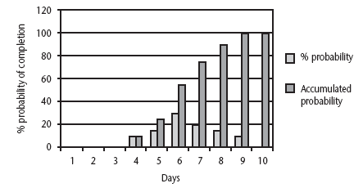
Risk Assessment - Probability chart
Notes:
The testing of a software component is scheduled to take six days, but is actually done in three days. A team leader might therefore feel justified in producing a probability chart where the probability of a task being completed in four days (5%), then five days (10%) and so on. The accumulated probability for the seventh day (65%) means that there is a 65% chance that the task will be finished on or before the seventh day.

Slide 14
Risk Assessment
Most managers resist very precise estimates of loss or of the probability of something occurring, as such figures are usually guesses.
Barry Boehm has suggested that, both the risk losses and the probabilities be assessed using relative scales in the range of 0 to 10. The two figures could then be multiplied together to get a notional risk exposure. This value can then be used to prioritize importance the risks.

Slide 15
Amanda’s risk exposure assessment
 | Hazard | Likelihood | Impact | Risk exposure
R1 | Changes to requirement specifications during coding | 8 | 8 | 64
R2 | Specification takes longer than expected | 3 | 7 | 21
R3 | Significant staff sickness affecting critical activities | 5 | 7 | 35
R4 | Significant staff sickness affecting non-critical activities | 10 | 3 | 30
R5 | Module coding takes longer than expected | 4 | 5 | 20
R6 | Module testing demonstrates errors of deficiencies in design | 4 | 8 | 32

Slide 16
Risk Assessment
Using indicative numbers 0 to 10 is not completely satisfactory. The values are likely to be subjective and different analysts might pick different numbers.
Another approach
Use qualitative descriptions of the possible impact and the likelihood of each risk.
Consistency between assessors is facilitated by associating each qualitative description with a range of values.

Slide 17
Risk Probability: Qualitative Descriptors
Probability level | Range
High | Greater than 50% chance of happening
Significant | 30-50% chance of happening
Moderate | 10-29% chance of happening
Low | Less than 10% chance of happening
Notes:
Managers would be happier identifying an approximate range rather than a precise probability.

Slide 18
Qualitative Descriptors of Impact on Cost and Associated Range Values
Impact level | Range
High | Greater than 30% above budgeted expenditure
Significant | 20 to 29% above budgeted expenditure
Moderate | 10 to 19% above budgeted expenditure
Low | Within 10% of budgeted expenditure.
Notes:
Similar tables can be produced for the impact on project duration and on the quality of project deliverables.
The problem with the qualitative approach is how do you combine the judgements about probability and impact – you can’t multiply them together.

Slide 19
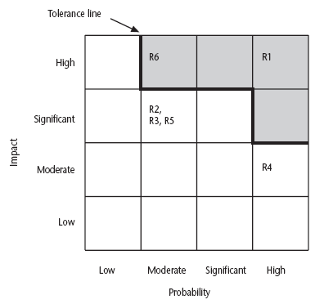
Probability Impact Matrix
Notes:
R1, R2 etc refer to particular risks (See Table 7.4 in the textbook). They are located on the grid according to the likelihood and impact ratings that have been allocated to them. A zone around the top right hand corner of the grid can be designated and risks falling within that zone are treated as requiring urgent action.

Slide 20
Risk planning
Risks can be dealt with by:
Risk acceptance – do nothing
Risk avoidance
Risk reduction and mitigation
Risk transfer
Notes:
Risk acceptance – the cost of avoiding the risk may be greater than the actual cost of the damage that might be inflicted
Risk avoidance – avoid the environment in which the risk occurs e.g. buying an OTS application would avoid a lot of the risks associated with software development e.g. poor estimates of effort.
Risk reduction – the risk is accepted but actions are taken to reduce its likelihood e.g. prototypes ought to reduce the risk of incorrect requirements
Risk transfer – the risk is transferred to another person or organization. The risk of incorrect development estimates can be transferred by negotiating a fixed price contract with an outside software supplier.
Risk mitigation – tries to reduce the impact if the risk does occur e.g. taking backups to allow rapid recovery in the case of data corruption

Slide 21
A risk that has a potential damage of $40,000 and a probability of occurrence of 12% will be given a higher priority than a risk having a potential damage of $35,000 and a likelihood of 14%. ( True / False)
Risk exposure = potential damage * probability of occurrence (likelihood)
Risk exposure for risk1 = 40,000*0.12 = $48,000
Risk exposure for risk2 = 35,000*0.14 = $49,000
Answer - FALSE
Obviously risk2 should be given higher priority.

Slide 22
Risk Management
Contingency
Contingency Plan – a planned action to be carried out if the particular risk materializes.
Example
staff member absence due to illness – replace with another staff member to cover the work

Slide 23
Risk Management
Deciding on the Risk Actions
The countermeasures considered must be cost-effective.
The cost-effectiveness of a risk reduction action can be assessed by calculating the Risk Reduction Leverage (RRL).
RRL = (RE_{before} – RE_{after}) / (cost of risk reduction)
An RRL above 1.00 indicates that the reduction in risk exposure achieved by a measure is greater than its cost.

Slide 24
Risk Management
Example
Risk reduction leverage =
(RE_{before}- RE_{after})/ (cost of risk reduction)
RE_{before} is risk exposure before risk reduction e.g. 1% chance of a fire causing $2,00,000 damage
RE_{after} is risk exposure after risk reduction e.g. fire alarm costing $500 reduces probability of fire damage to 0.5%
RRL = (1% of $2,00,000)-(0.5% of $2,00,000)/£500 = 2
RRL > 1.00 therefore worth doing
Notes:
If you think in terms of the analogy to insurance. An insurance company might reduce the fire insurance premium from £2k to £1k on condition that a fire alarm is installed. The insured would save £1k a year by investing £500 so it would be worth doing.

Slide 25
Applying the PERT Technique
Using PERT to evaluate the effects of uncertainty
PERT was developed to take account of the uncertainty surrounding estimates of task durations.
PERT requires three estimates of durations
Most likely time: the time we would expect the task to take under normal circumstances. We shall identify this by the letter m.
Optimistic time: the shortest time in which we could expect to complete the activity, barring outright miracles. We shall identify this by the letter a.
Pessimistic time: the worst possible time, allowing for all reasonable eventualities. We shall call this b.

Slide 26
Applying the PERT Technique
PERT then combines these three estimates to form a single expected duration, t_{e} , using the formula
t_{e} = (a + 4m + b) / 6

Slide 27
A project specification with estimated activity durations for a, m and b, and precedence requirements. Calculate the expected duration, t_{e} for each activity.
Activity | Optimistic (a) | Activity Durations (weeks) Most likely (m) | Pessimistic (b) | Precede-nts
A Hardware selection | 5 | 6 | 8
B Software design | 3 | 4 | 5
C Install hardware | 2 | 3 | 3 | A
D Code and test software | 3.5 | 4 | 5 | B
E File take-on | 1 | 3 | 4 | B
F Write user manuals | 8 | 10 | 15
G User training | 2 | 3 | 4 | E,F
H Install and test system | 2 | 2 | 2.5 | C,D

Slide 28
Applying the PERT Technique
Using Expected Durations
the expected durations are used to carry out a forward pass through a network.
Calculated event dates are not the earliest possible dates but the dates by which we expect to achieve those events.

Slide 29
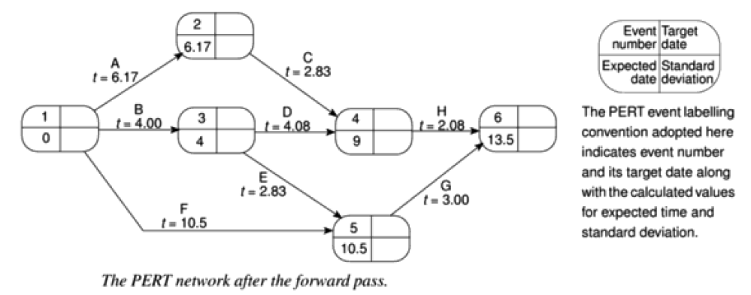
Applying the PERT Technique

Slide 30
Applying the PERT Technique
Activity Standard Deviations
A quantitative measure of the degree of uncertainty of an activity duration estimate may be obtained by calculating the standard deviation ‘s’ of an activity time, using the formula
s = (b – a) / 6
can be used as a ranking measure of the degree of uncertainty or risk for each activity.

Slide 31
Expected Times and Standard Deviations
 | Activity Durations (Weeks)
Activity | Optimistic (a) | Most likely (m) | Pessimistic (b) | Expected (t_{e}) | Standard Deviation (s)
A | 5 | 6 | 8 | 6.17 | 0.50
B | 3 | 4 | 5 | 4.00 | 0.33
C | 2 | 3 | 3 | 2.83 | 0.17
D | 3.5 | 4 | 5 | 4.08 | 0.25
E | 1 | 3 | 4 | 2.83 | 0.50
F | 8 | 10 | 15 | 10.50 | 1.17
G | 2 | 3 | 4 | 3.00 | 0.33
H | 2 | 2 | 2.5 | 2.08 | 0.08

Slide 32
Applying the PERT Technique
The likelihood of meeting targets
Advantage of PERT
it provides a method for estimating the probability of meeting or missing target dates.
There might be only a single target date – the project completion
but we might even set additional intermediate targets
Example : Assume the project must be completed within 15 weeks, activity C must be completed by week 10 and event 5 represents the delivery of intermediate product to the customer, which must take place by week 10.

Slide 33
Applying the PERT Technique
The PERT technique uses a three-step method to calculate the probability of meeting or missing a target date:
Calculate the standard deviation for each project event;
can be calculated by carrying out a forward pass using the activity standard deviations
to add two standard deviations we must add their squares and then find the square root of the sum
Example: For event 5 there are two possible paths, B + E or F. The total standard deviation for path B + E is
√ (0.33² + 0.50²) = 0.6 and that for path F is 1.17. The standard deviation for event 5 is therefore the greater of the two, 1.17.

Slide 34
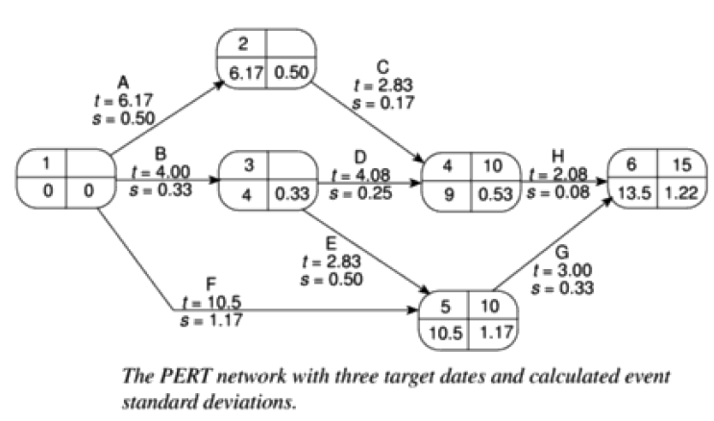
Applying the PERT Technique

Slide 35
Applying the PERT Technique
Calculate the ‘z’ value for each event that has a target date
Equivalent to the number of standard deviations between the node’s expected and target dates.
Calculated using the formula
z = ( T – t_{e} ) / s
Example:
The z value for event 4 is (10 – 9.00) / 0.53 = 1.8867

Slide 36
Applying the PERT Technique
Convert ‘z’ values to probabilities using the graph
Example: the ‘z’ value for project completion (event 6) is 1.23. In the graph this equates to a probability of approximately 11%, that is, there is 11% risk of not meeting the target date of the end of week 15.

Slide 37
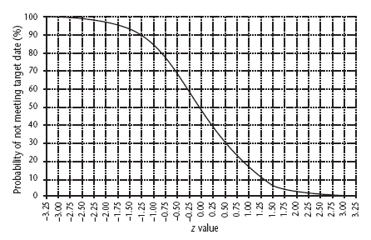
Graph of z values

Slide 38
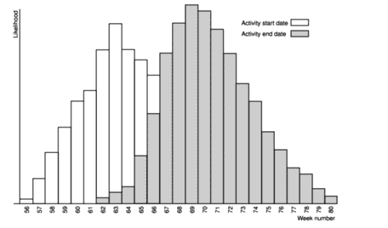
Risk Schedule Evaluation
PERT
Monte Carol Simultion
The automated software packages apply the Monte-Carlo simulation not only to schedules but also evaluate risks related to cost and resources along with regular schedule estimations.

Slide 39
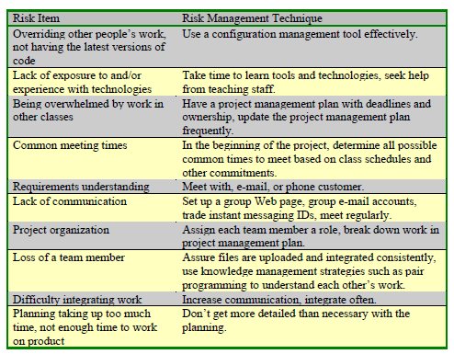
Risk Management in Educational Projects

Slide 40
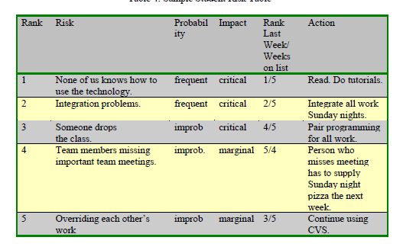
Sample Student Risk Table

Slide 41
To be done in class room
List the major risks that might affect your next programming assignment and identify strategies for minimizing each of those risks.
List the top risks that may happen in the highly user friendly web based development project and also provide the risk table for the same.
Track the various risk tools over net.

